Slide 1
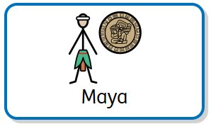
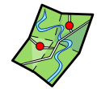





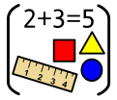



Homework activities are intended to be as open ended as possible, allowing the children to reflect on their learning in class in a creative way. The optional tasks are to help children explore their interests and make their own decisions on how to collect, record and present their home learning. We hope you have fun learning.
Research and present the Mayan timeline. | Teach someone to play the Mayan game Pok a Tok. Can you write instructions? | Create a map of your own Mayan City state. | Draw a Mayan God and give a description. | Create a Mayan mosaic.
Write calculations using the Mayan number system. | Draw and design your own Mayan pyramid. | Give reasons why the Maya traded. | Write a food diary. What foods do you think would have been available for the Maya? | The Maya made many masks. Construct a Mayan animal mask.

